Slide 1
Lecture 4
Distributed Version Control
and Git

Slide 2
Outline
Introduction to Version Control Systems
Terminology
Centralized VS Distributed Version Control
Data Storage in SVN vs Git
Git
Object Model
Basic Operations
Collaboration

Slide 3
Motivation

Slide 4
Bob

Slide 5
Bob
Carol

Slide 6
Bob
Carol
Alice
Ted

Slide 7
Bob
Carol
Alice
Ted
A recipe for disaster!

Slide 8
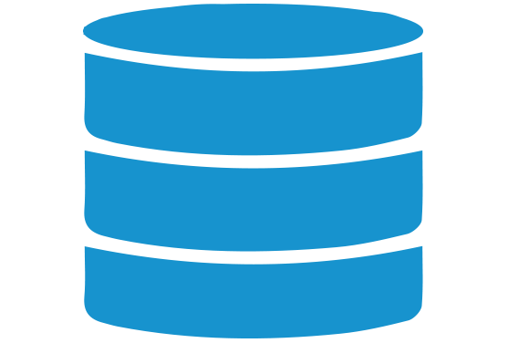
Bob
Carol
Version Control System (VCS)
Alice
Collaboration
Storing version properly
Restoring previous versions
Understanding what happened
Backup
Ted

Slide 9
Some Terminology
Repository
The place where developers store all their work
Not only stores files but also the history
Accessed over the network
Branches
Used to create another line of development, e.g. when you want your development process to fork into 2 different directions
Working Copy
A snapshot of the repository
Private workplace where developers can do their work remaining isolated from the rest of the team
Commit (Check in) & Update (Check out) Changes
Process of storing changes from private workplace to a central server
Changes are then made available to the rest of the team
Notes:
9

Slide 10

Some Terminology
Repository
The place where developers store all their work
Not only stores files but also the history of changes
Accessed over the network
Branches
Used to create another line of development, e.g. when you want your development process to fork into 2 different directions
Working Copy
A snapshot of the repository
Private workplace where developers can do their work remaining isolated from the rest of the team
Commit (Check in) & Update (Check out) Changes
Process of storing changes from private workplace to a central server
Changes are then made available to the rest of the team
Notes:
10

Slide 11
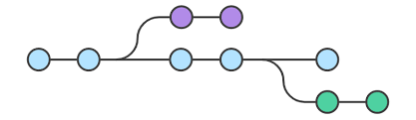
Some Terminology
Repository
The place where developers store all their work
Not only stores files but also the history of changes
Accessed over the network
Branches
Used to create another line of development, e.g. when you want your development process to fork into 2 different directions
Working Copy
A snapshot of the repository
Private workplace where developers can do their work remaining isolated from the rest of the team
Commit (Check in) & Update (Check out) Changes
Process of storing changes from private workplace to a central server
Changes are then made available to the rest of the team
Notes:
11

Slide 12



Some Terminology
Repository
The place where developers store all their work
Not only stores files but also the history of changes
Accessed over the network
Branches
Used to create another line of development, e.g. when you want your development process to fork into 2 different directions
Working Copy
A snapshot of the repository
Private workplace where developers can do their work remaining isolated from the rest of the team
Commit (Check in) & Update (Check out) Changes
Process of storing changes from private workplace to a central server
Changes are then made available to the rest of the team
Notes:
12

Slide 13
Some Terminology
Repository
The place where developers store all their work
Not only stores files but also the history of changes
Accessed over the network
Branches
Used to create another line of development, e.g. when you want your development process to fork into 2 different directions
Working Copy
A snapshot of the repository
Private workplace where developers can do their work remaining temp
Ora
rily isolated from the rest of the team
Commit (Checkin) & Update (Checkout) Changes
Checkin: stores changes from private workplace to the repository
Checkout: updates the files in the working directory to match the version stored in a branch
Notes:
13

Slide 14
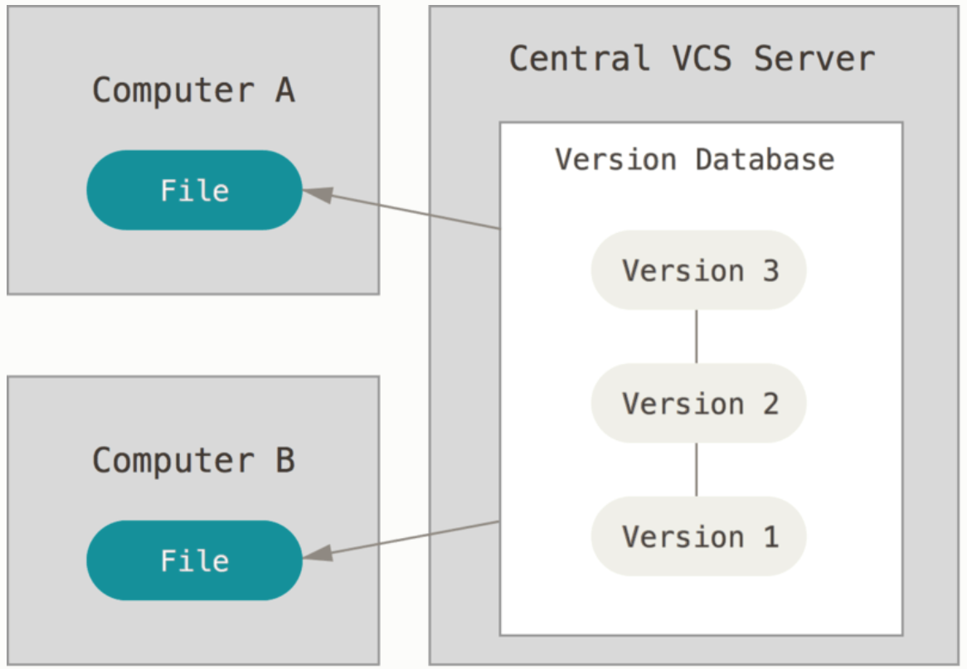

Centralised Version Control Systems
Examples: Subversion (SVN), CVS, Perforce
A central server repository (repo) holds the "official copy" of the code
the server maintains the sole version history of the repository
You make "checkouts" of it to your local copy
you make local modifications
your changes are not versioned
When you're done, you "check in" back to the server
your checkin increments the repo's version
Single point of failure

Slide 15
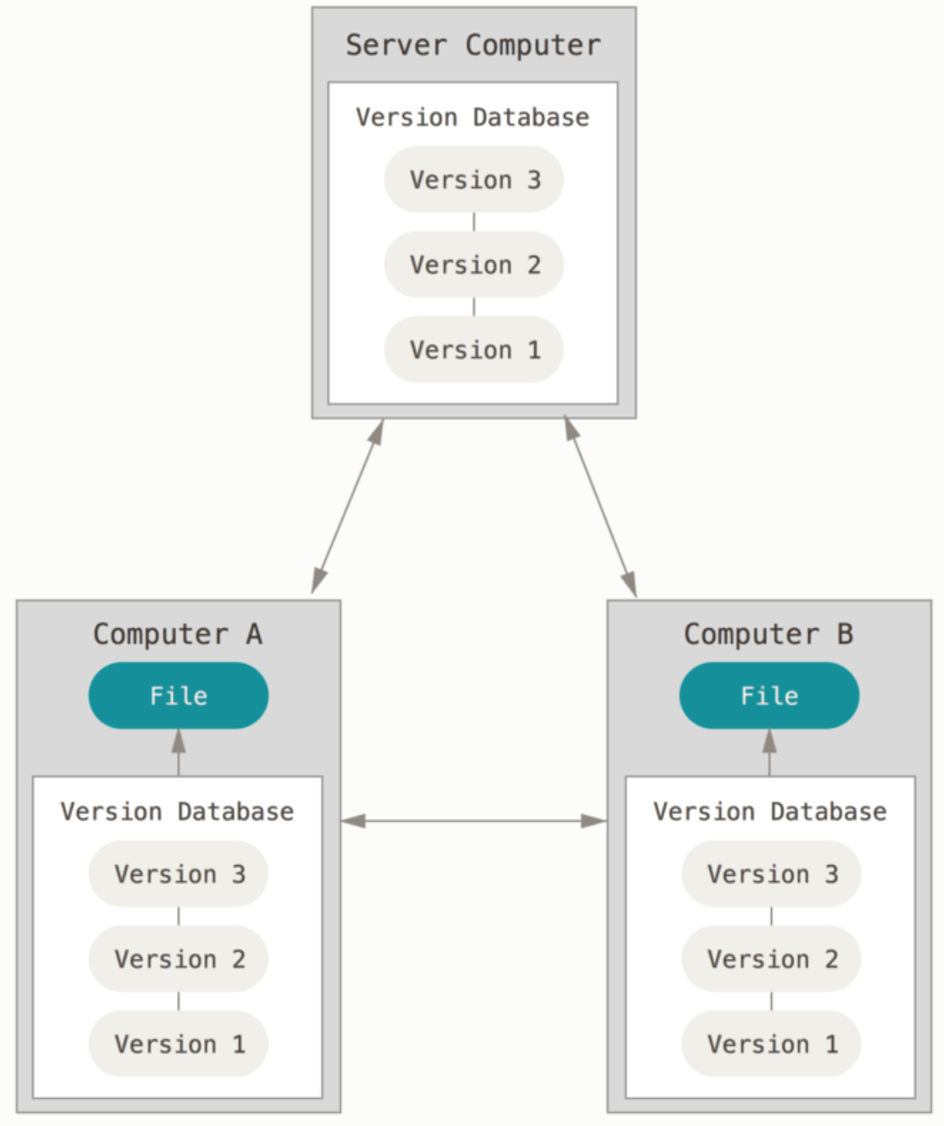
Distributed Version Control Systems
In Git, Mercurial you don't "checkout” from a central repo
you "clone" it and "pull" changes from it
Your local repo is a complete copy of everything on the remote server
yours is "just as good" as theirs
Many operations are local:
check in/out from local repo
commit changes to local repo
local repo keeps version history
When you're ready, you can "push" changes back to server
Most operations seem to be executed almost instantaneously.

Slide 16
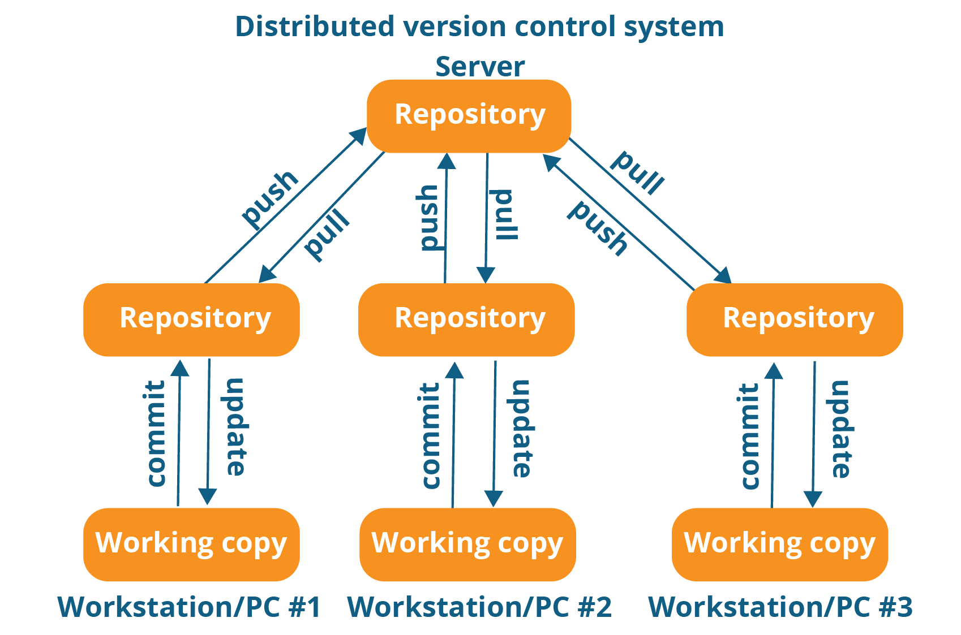
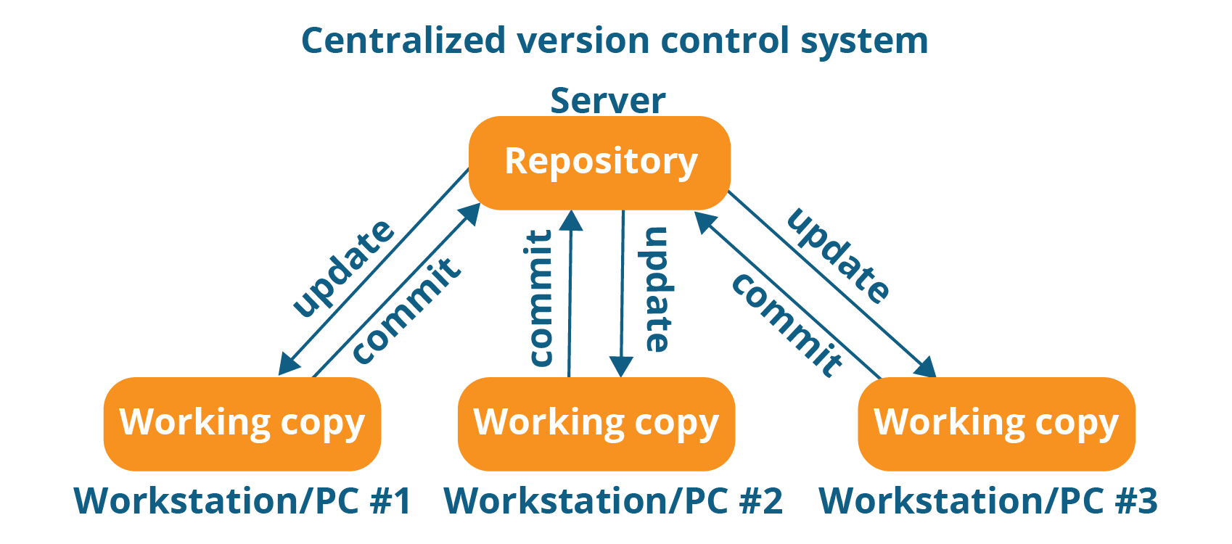
Version Control Systems
Centralized vs Distributed

Slide 17


About Git
Distributed VCS
Originally developed by Linus Torvalds, creator of Linux, in 2005
Designed to do version control on Linux kernel
Goals of Git:
Speed
Support for non-linear development (thousand of parallel branches)
Fully distributed
Able to handle large projects efficiently
(A “git ” is a cranky old man. Linus meant himself.)
Notes:
17

Slide 18
Installing/Learning Git
Git website: http://git-scm.com
Free on-line book: http://git-scm.com/book
Reference page for Git: http://gitref.org/index.html
Git tutorial: http://schacon.github.com/git/gittutorial.html
Git for Computer Scientist
http://eagain.net/articles/git-for-computer-scientists
Git Cheat Sheet
https://education.github.com/git-cheat-sheet-education.pdf
At command line (where verb = config, add, commit, etc.)
git help verb
Notes:
18

Slide 19

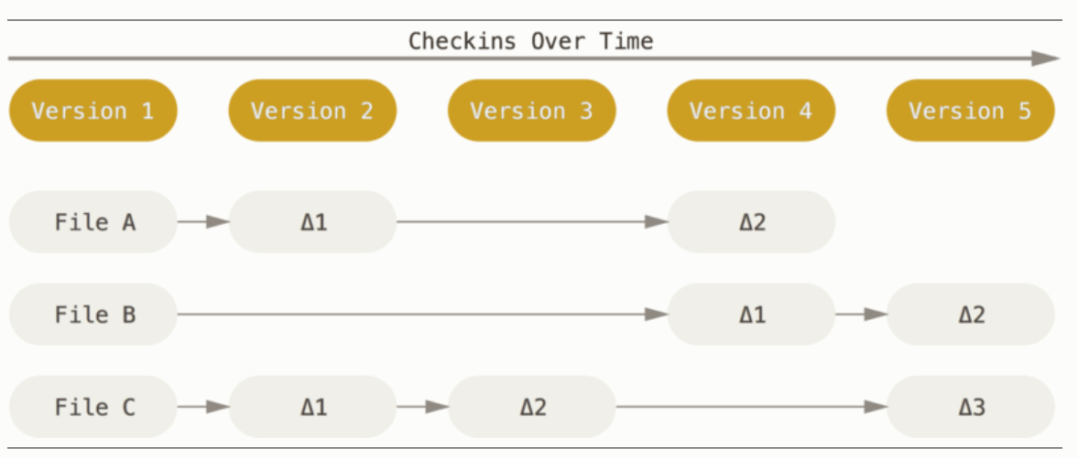

How Data Are Stored
SVN: Delta storage model
Data are stored as changes to a base version of the same file
Notes:
19

Slide 20
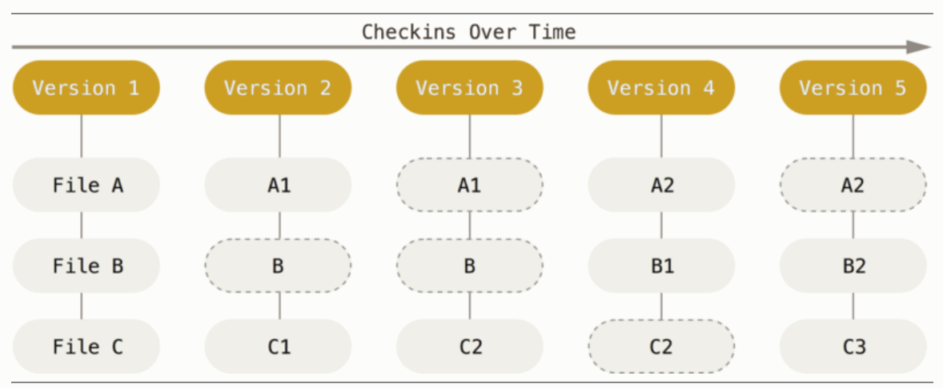
How Data Are Stored
Git: Snapshot storage model
Data are stored as snapshots of the project over time.
Some files change on a given check in, some do not.
More redundancy, but faster
If not changed, a link to the previous identical file it has already stored
.
Notes:
20

Slide 21
Most Important Thing to Remember About Git
A File can be in 3 main states:
Modified: the file has been changed but not yet committed.
Staged: the file is marked as modified and will be included in the next commit snapshot. => Every commit is "hand-crafted”
Committed: the data is safely stored in your local database.
Notes:
21

Slide 22
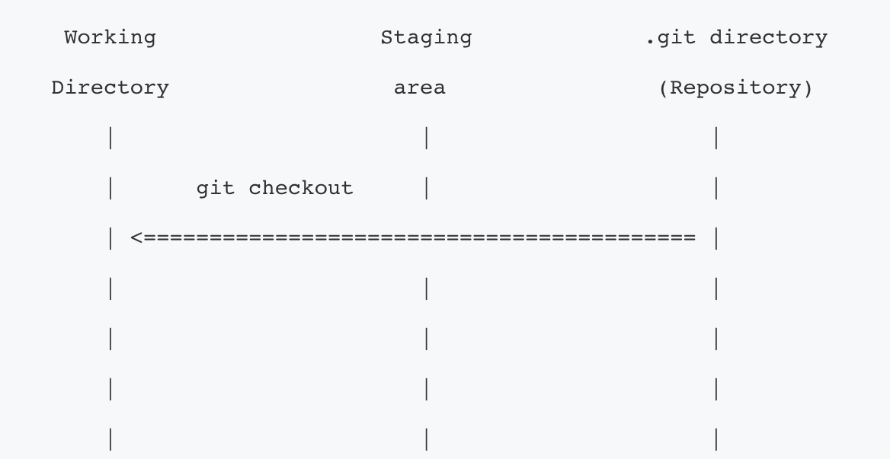
Git Workflow
Modified
Notes:
22

Slide 23
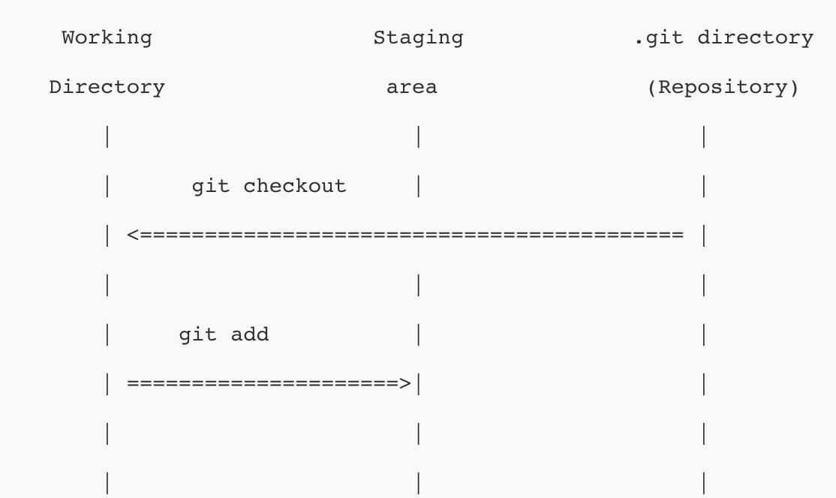
Git Workflow
Staged
Notes:
23

Slide 24
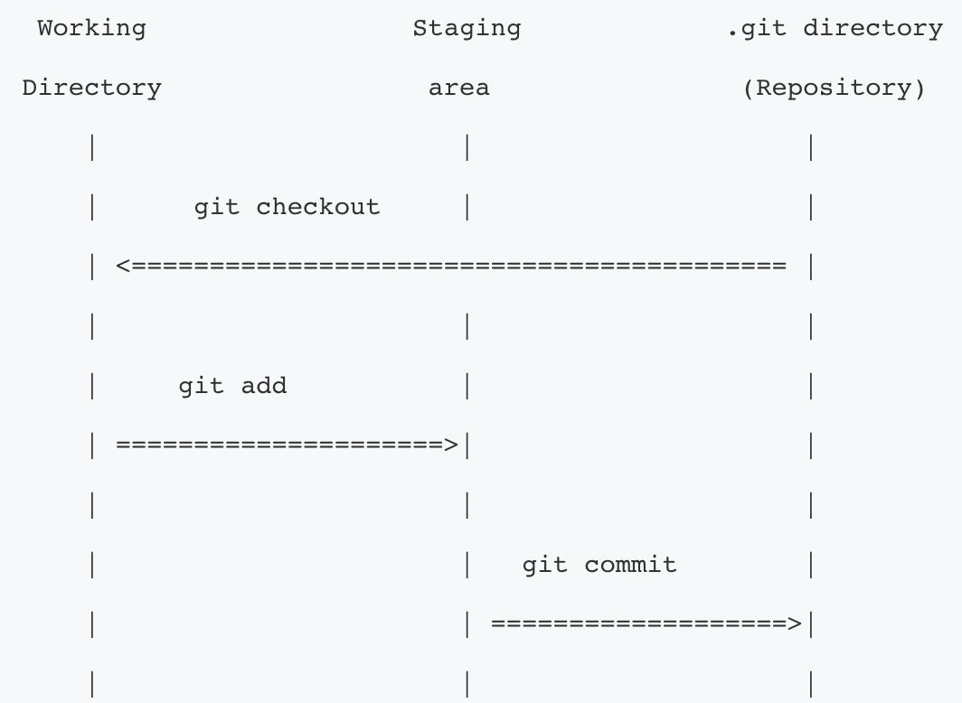
Git Workflow
Committed
Notes:
24

Slide 25
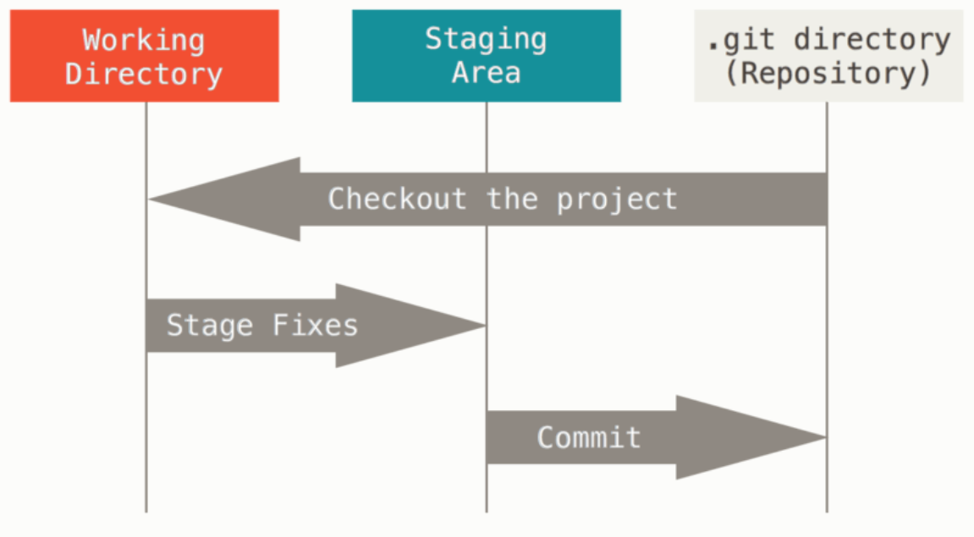
Most Important Thing to Remember About Git
A File can be in 3 main states:
Modified: the file has been changed but not yet committed.
Staged: the file is marked as modified and will be included in the next commit snapshot.
Committed: the data is safely stored in your local database.
Main Sections of a Git project (created locally on your machine)
Notes:
25

Slide 26
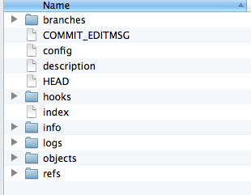
Most Important Thing to Remember About Git
A File can be in 3 main states:
Modified: the file has been changed but not yet committed.
Staged: the file is marked as modified and will be included in the next commit snapshot.
Committed: the data is safely stored in your local database.
Main Sections of a Git project (created locally on your machine)
Metadata and object database for the project.
This is what is copied when a repository is cloned from another computer.
Notes:
26

Slide 27
Most Important Thing to Remember About Git
A File can be in 3 main states:
Modified: the file has been changed but not yet committed.
Staged: the file is marked as modified and will be included in the next commit snapshot.
Committed: the data is safely stored in your local database.
Main Sections of a Git project (created locally on your machine)
Single checkout of one version of the project.
These files are pulled out of the compressed database in the .git directory and placed on disk for you to use or modify.
Notes:
27

Slide 28
Most Important Thing to Remember About Git
A File can be in 3 main states:
Modified: the file has been changed but not yet committed.
Staged: the file is marked as modified and will be included in the next commit snapshot.
Committed: the data is safely stored in your local database.
Main Sections of a Git project (created locally on your machine)
It is a file, generally contained in your .git directory, that stores information about what will go into your next commit.
Notes:
28

Slide 29
The Git object model

Slide 30
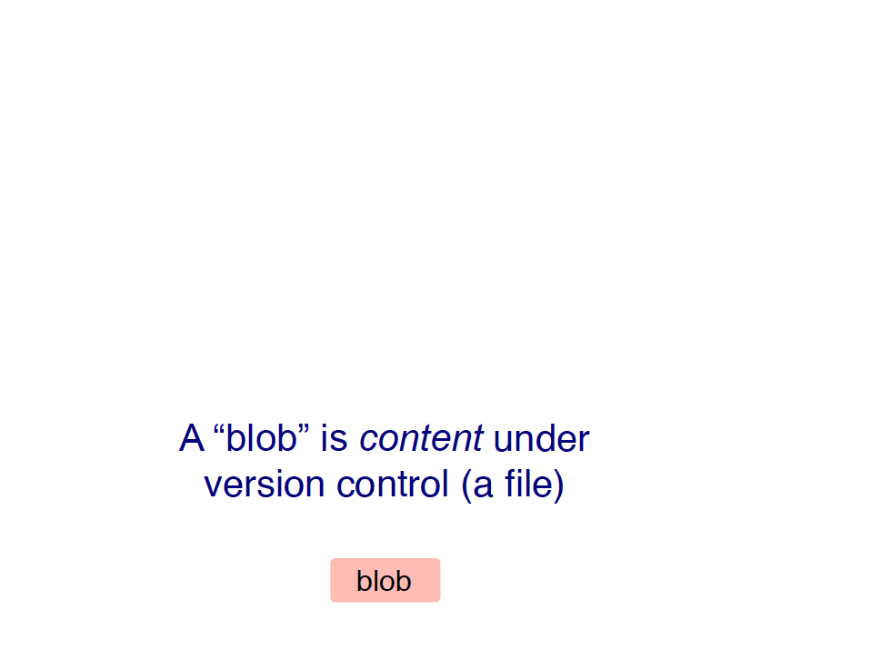

Slide 31
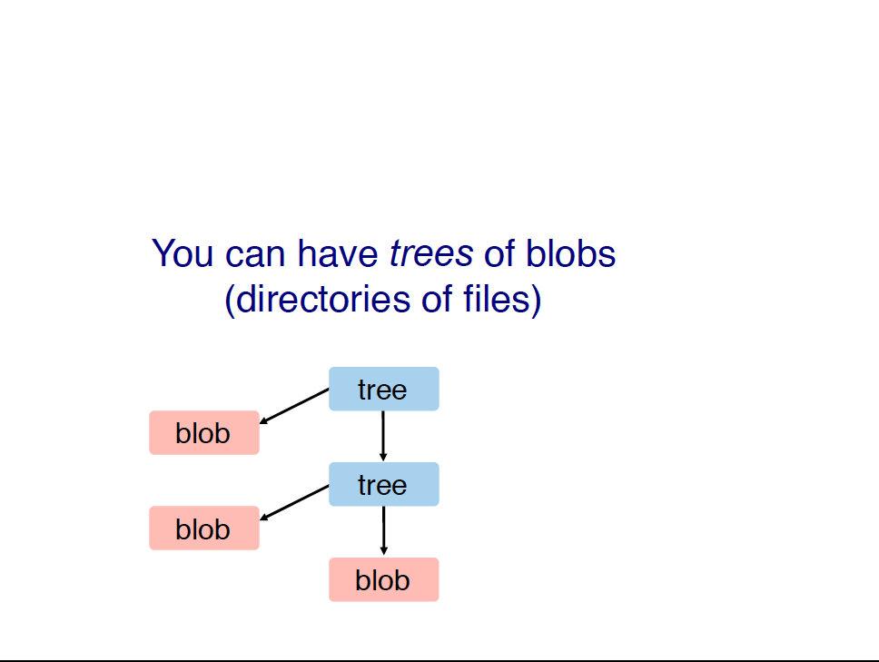

Slide 32
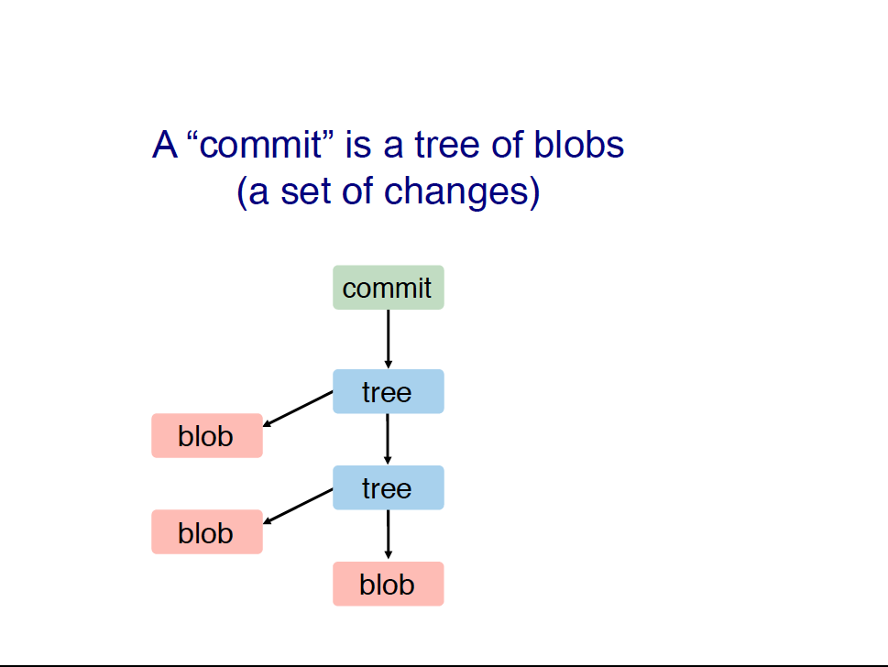

Slide 33
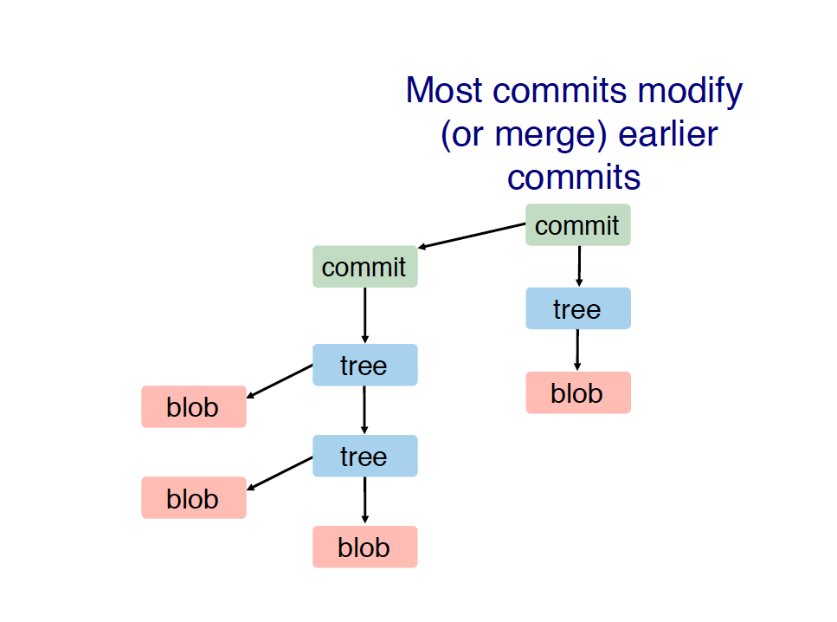

Slide 34
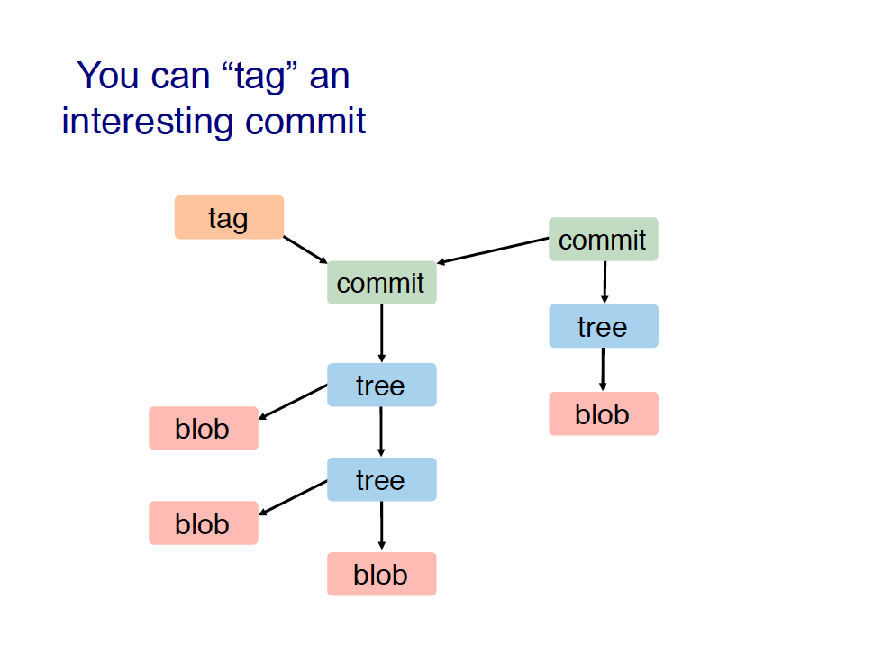

Slide 35
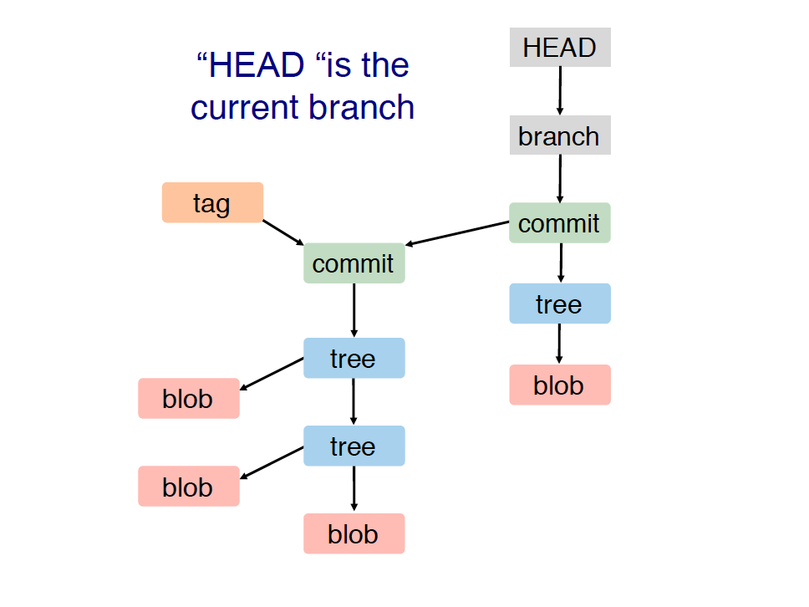

Slide 36
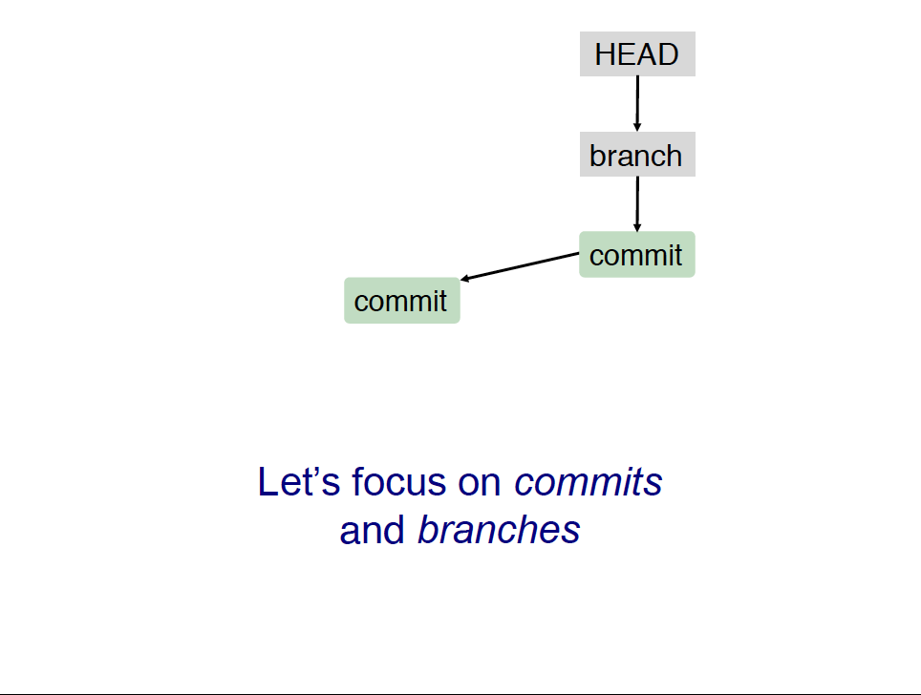
We will focus on commits only for one branch

Slide 37
Git Basic Operations

Slide 38
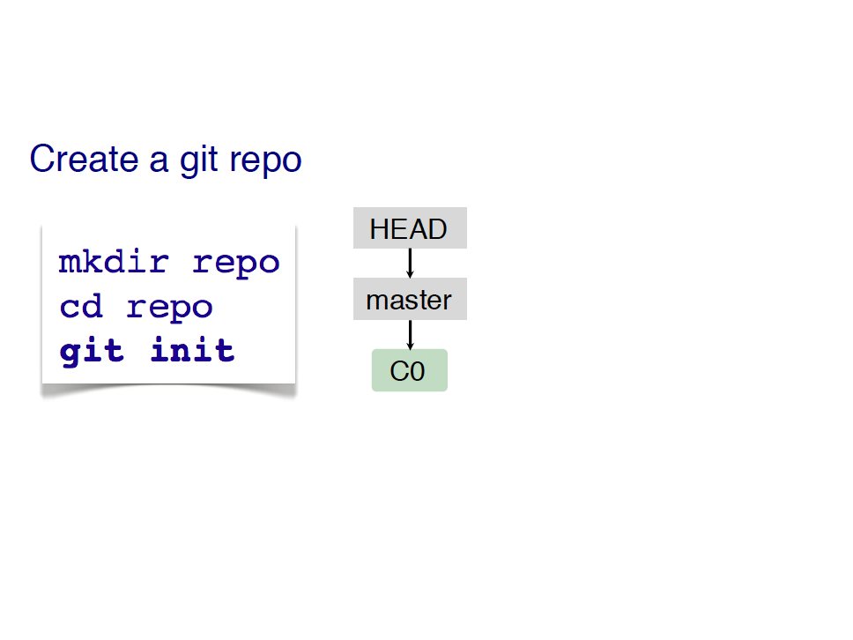

Slide 39
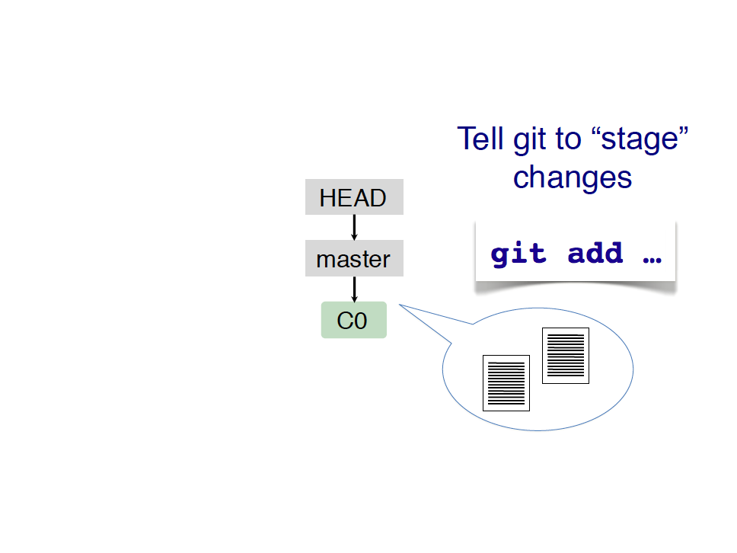

Slide 40
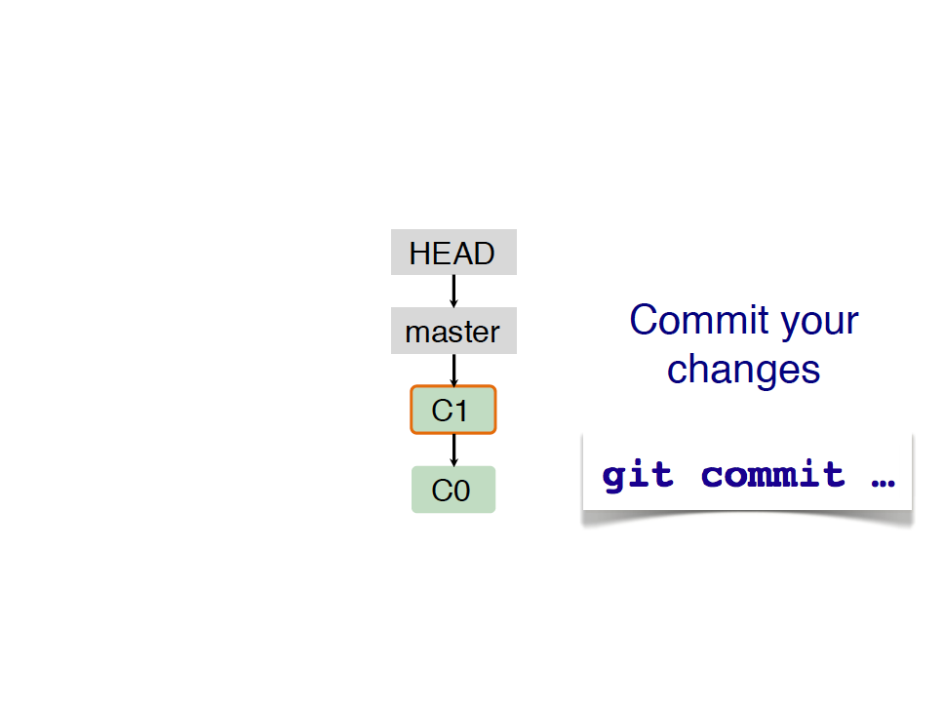

Slide 41
Collaborating

Slide 42
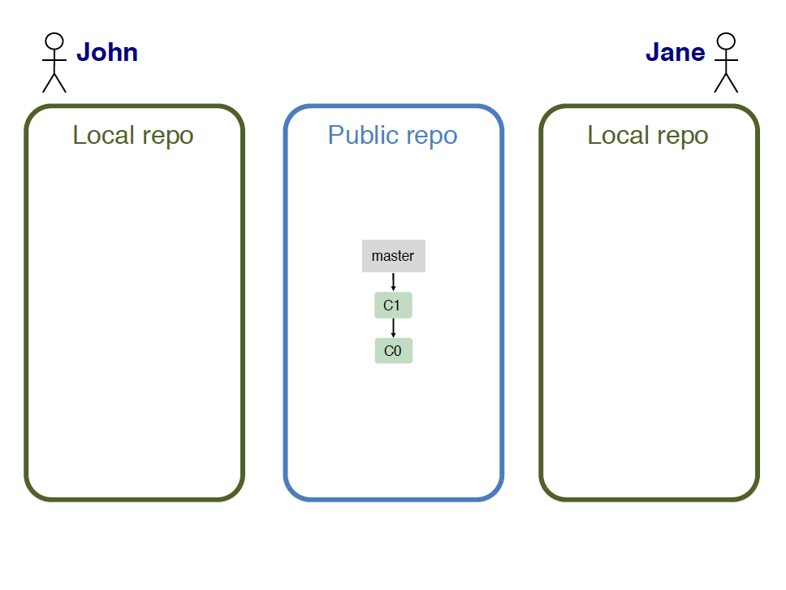

Slide 43
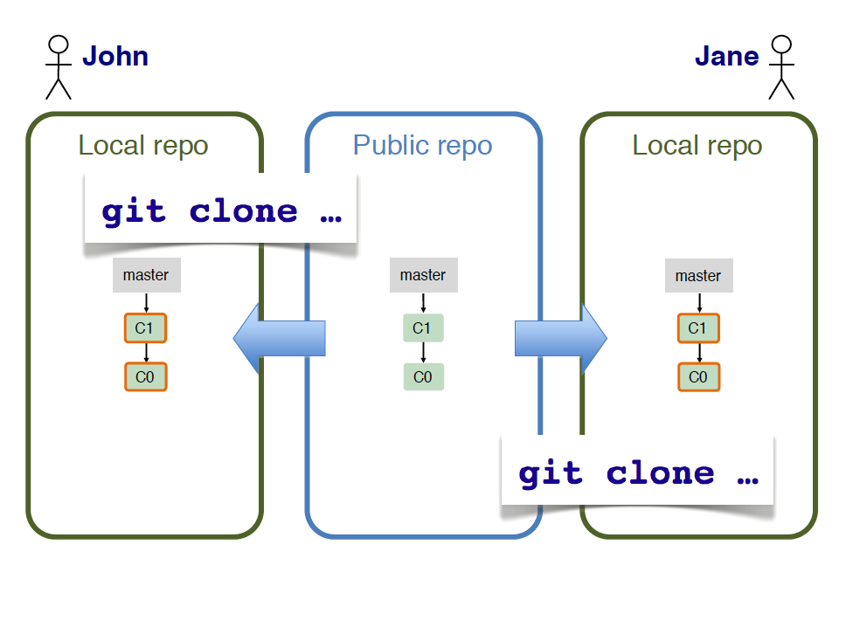

Slide 44
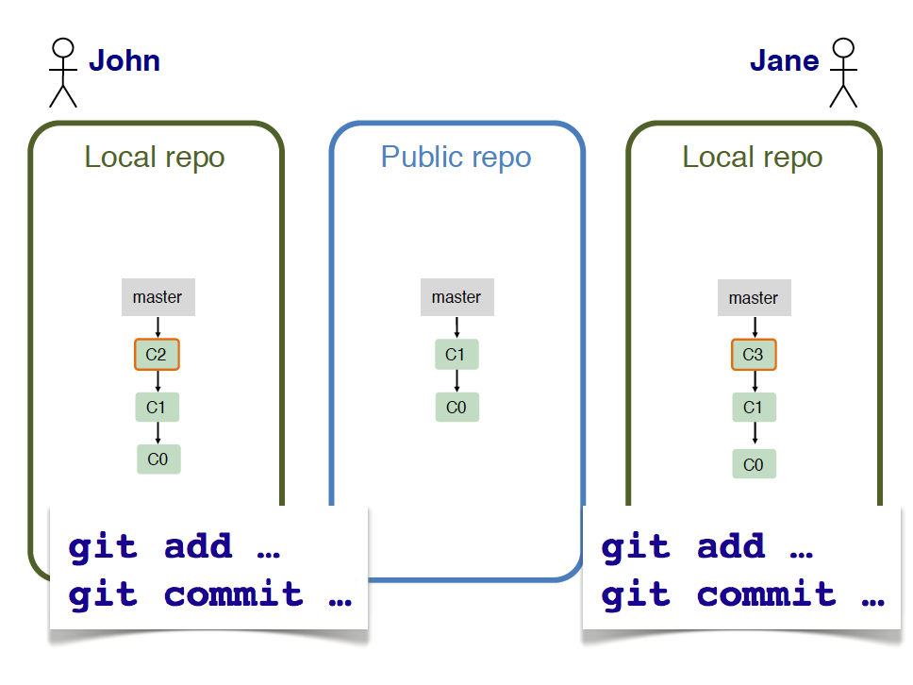

Slide 45
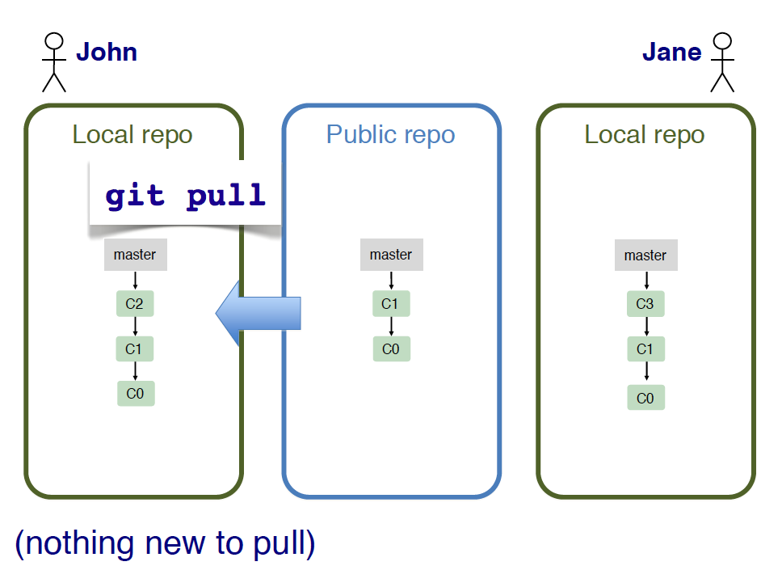

Slide 46
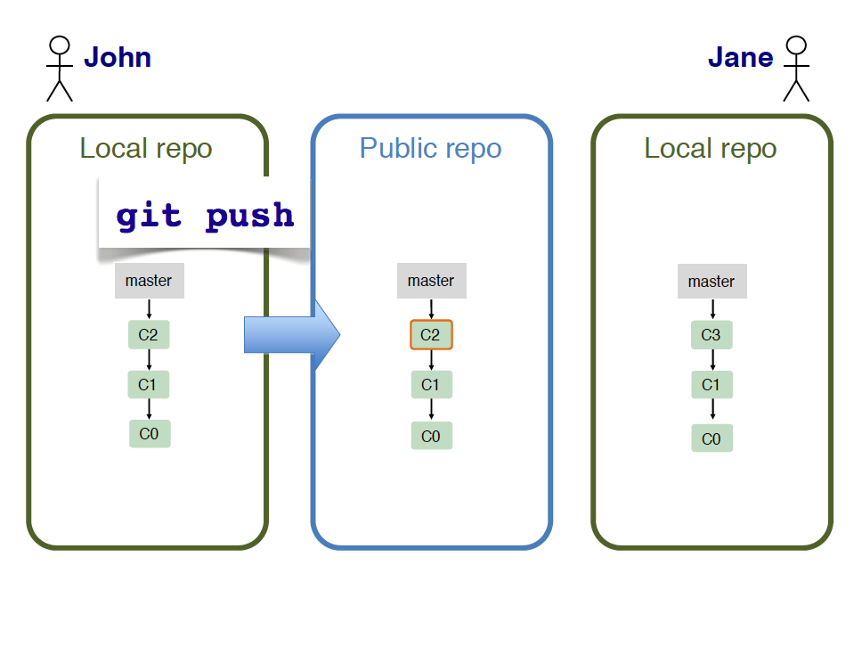

Slide 47
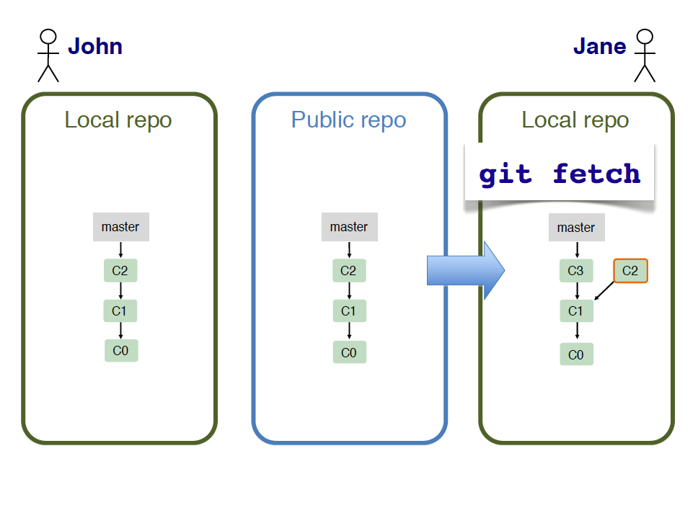

Slide 48
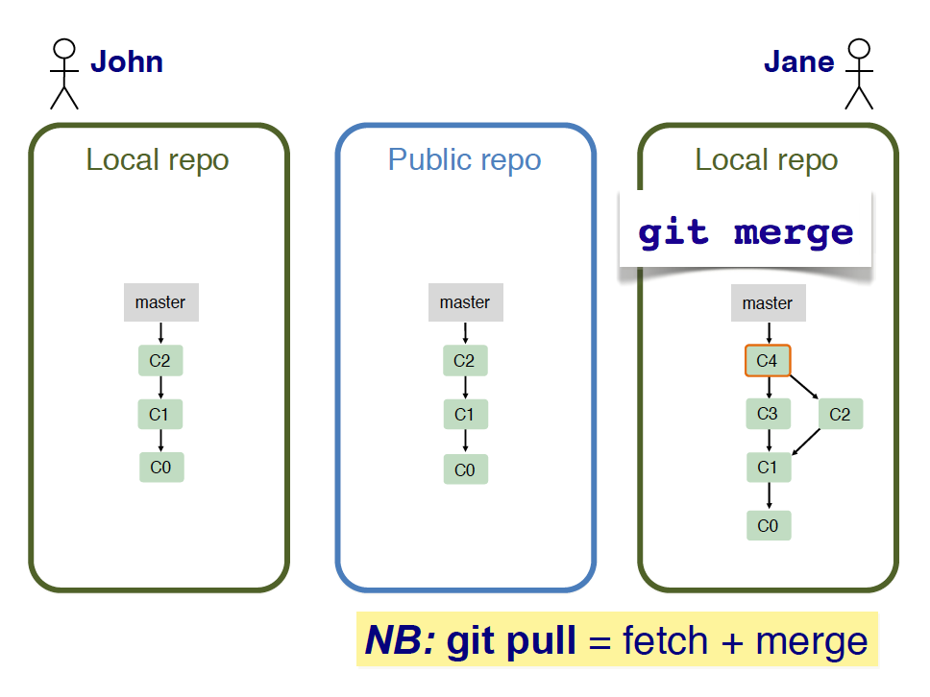

Slide 49
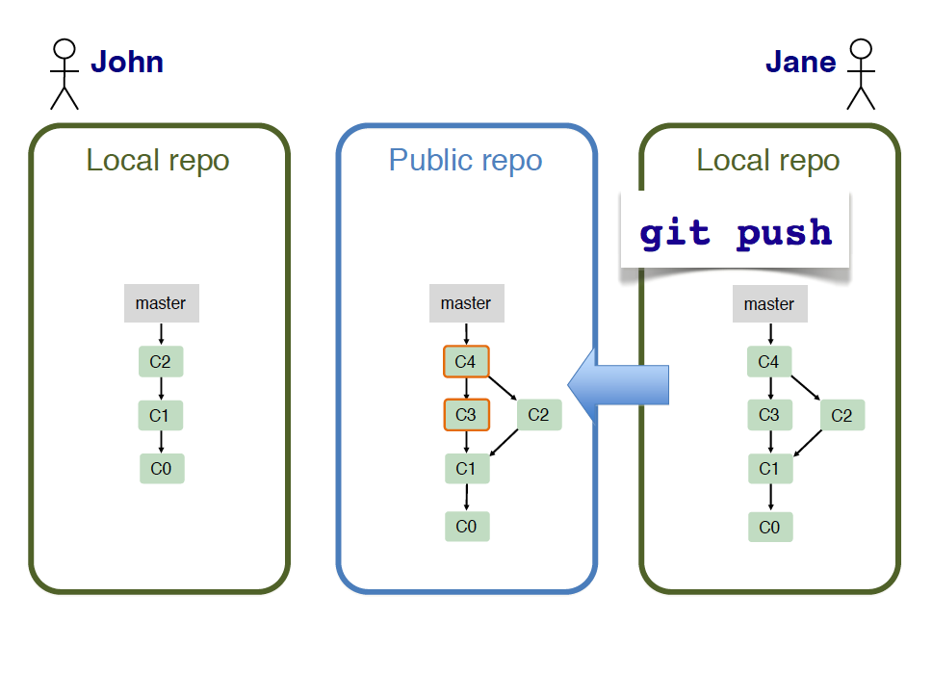

Slide 50
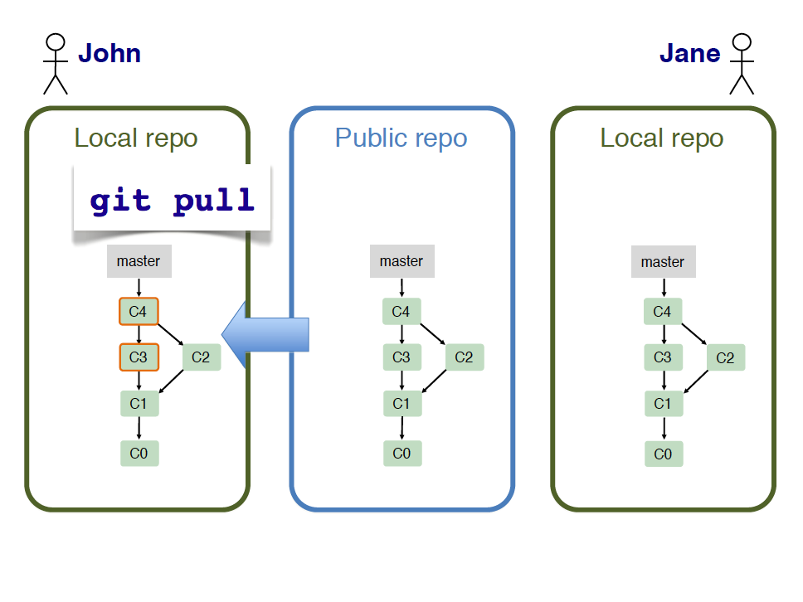

Slide 51
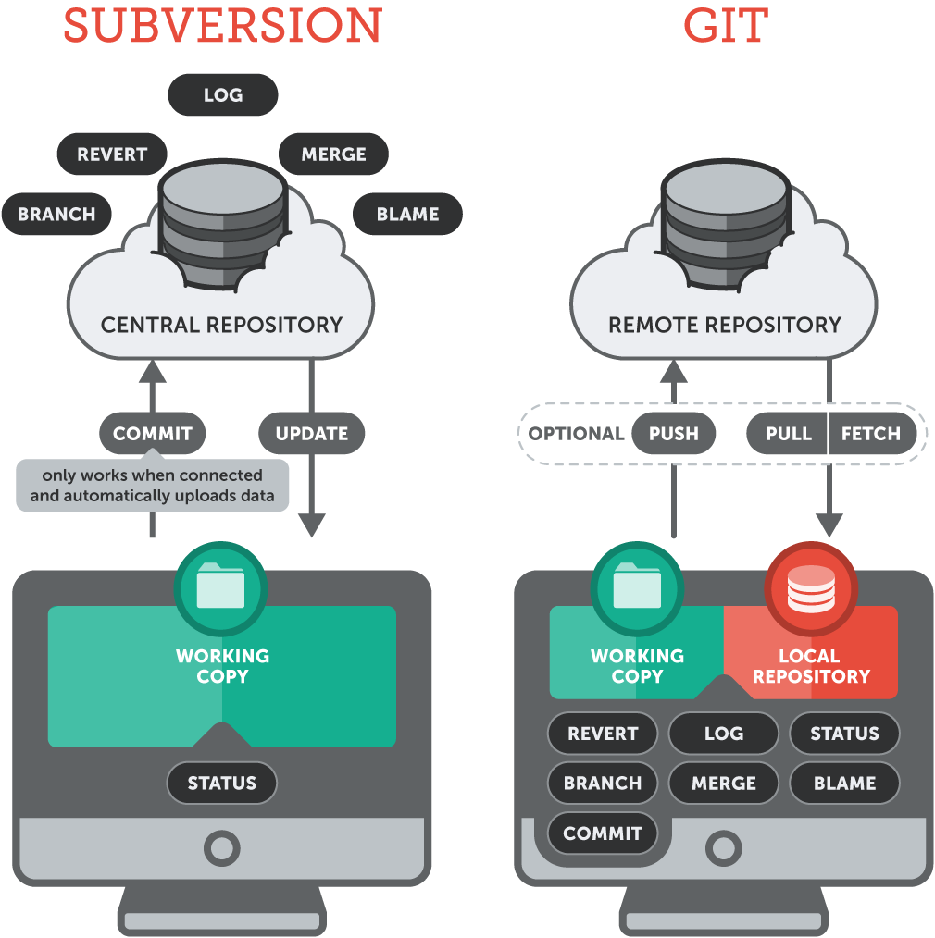
Wrap Up
https://www.git-tower.com/learn/git/ebook/en/desktop-gui/appendix/from-subversion-to-git
Notes:
51

Slide 52
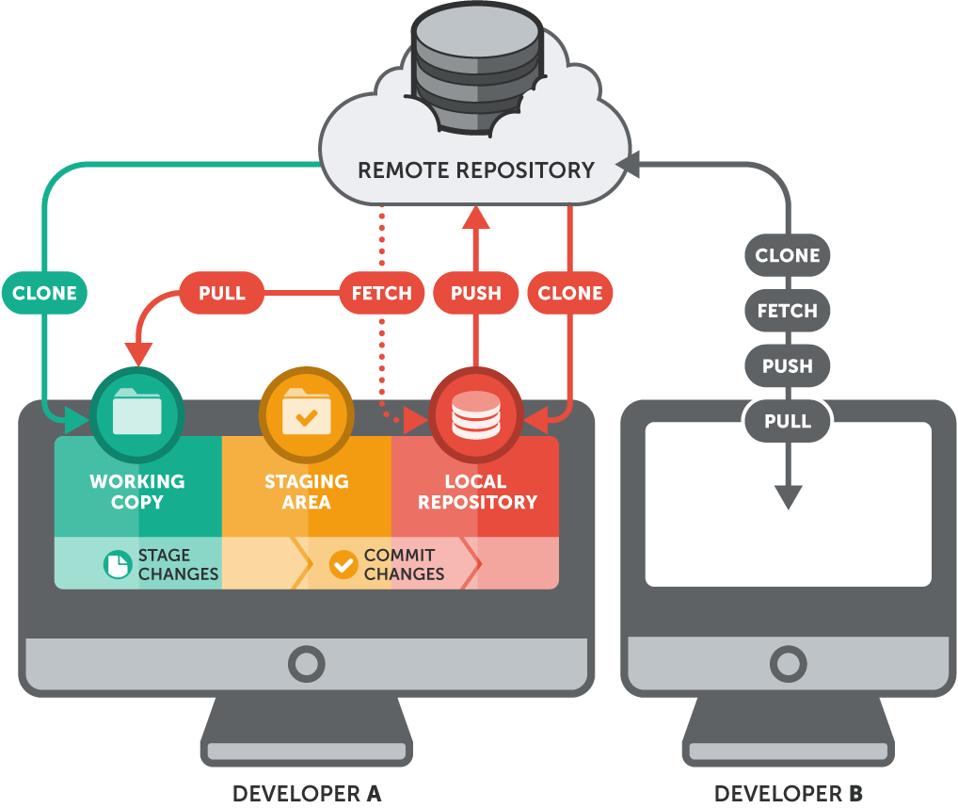
Wrap Up
https://www.git-tower.com/learn/git/ebook/en/command-line/remote-repositories/introduction
Notes:
for bug fixes
52

Slide 53

GitLab and GitHub
GitLab.com and GitHub.com are sites for online storage of Git repositories:
You can create a remote repository and push code to it.
You can get space for open source projects.
Question: Do I always have to use GitHub or GitLab to use git?
Answer: No. You can still use git locally for your own purposes.
Alternatively, you or someone else could set up a server to share files.

Slide 54
More to git …
Merging and merge tool
Squashing commits when merging
Resolving conflicts
User authentication with ssh
Smartgit and other graphical interface for git commands
git configure — remembering your name
git remote — multiple remote repos
gitlab — an open source public repo
…

Slide 55
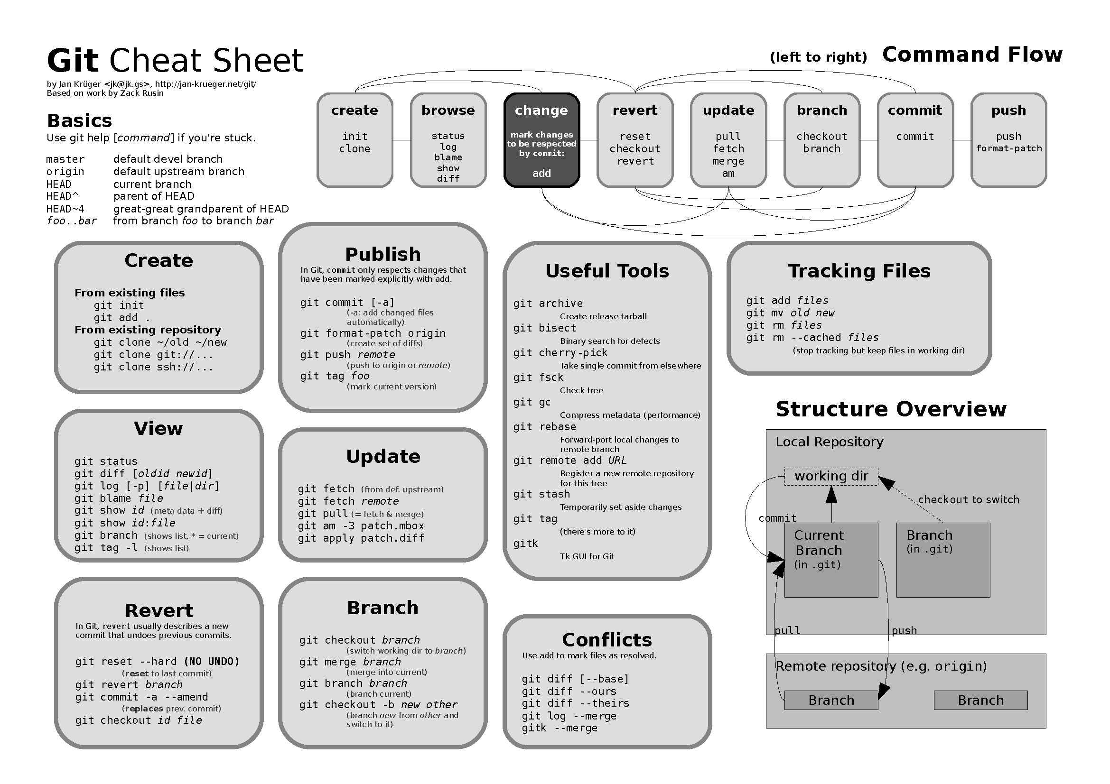
More to git …

Slide 56



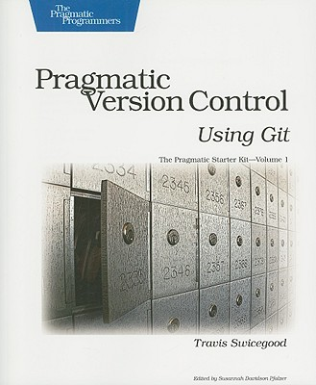
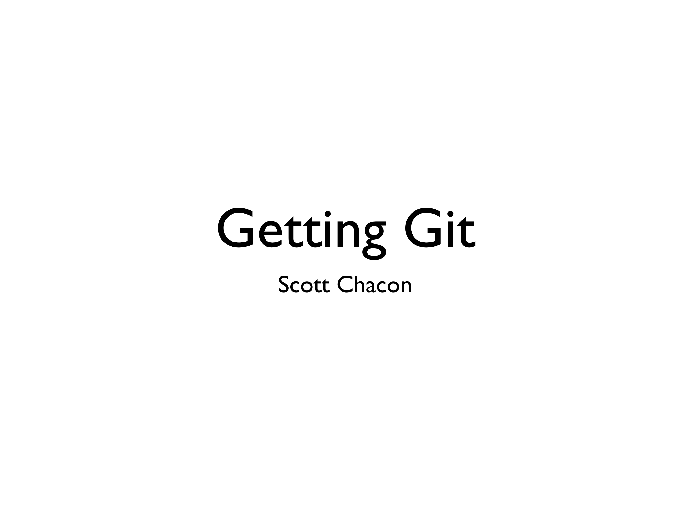
Resources
http://git-scm.com/
http://book.git-scm.com/index.html
https://gitlab.com/
http://www.slideshare.net/chacon/getting-git
http://oreilly.com/

